Slide 1
Communicating with Data – Basic Charts
Dr. Ab Mosca (they/them)
Slides based off slides courtesy of Jordan Crouser (https://jcrouser.github.io/)

Slide 2
Plan for Today
A sampling of visualization techniques
Tableau Live Demo
Lab 2: Building charts in Tableau

Slide 3
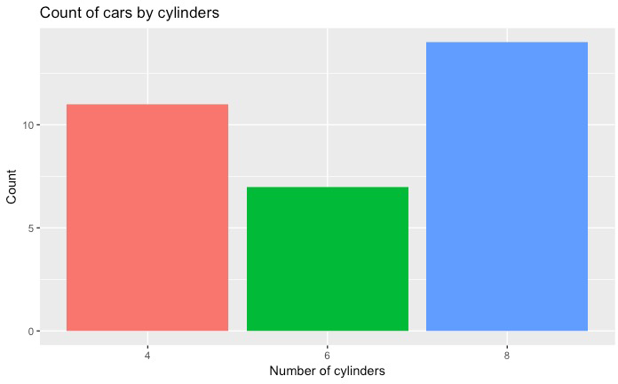
Used to show quantitative variable X categorical variable
Compares quantitative values for different categories
Highlights relative amounts
Grouped/stacked bars can break each category into sub-groups
Bar chart

Slide 4
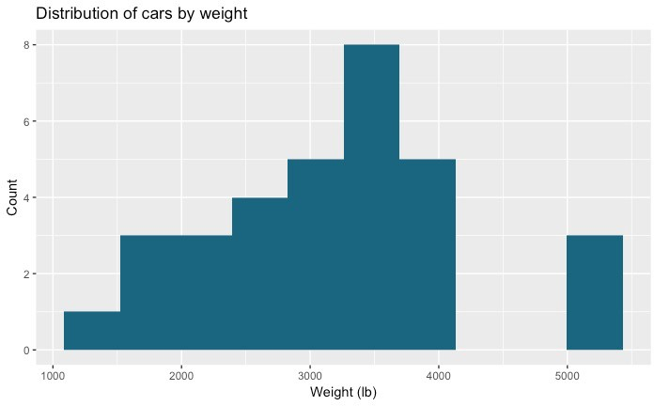
Used for one quantitative variable
Looks like a bar chart… but the x-axis consists of equal size ranges (bins) for the quantitative variable
Y-axis shows count or relative frequency
Highlights distribution
Note: bin size makes a big difference!
Histogram
10-14
25-29
45-49
50-54
20-24
30-34
40-44
15-19
35-39

Slide 5
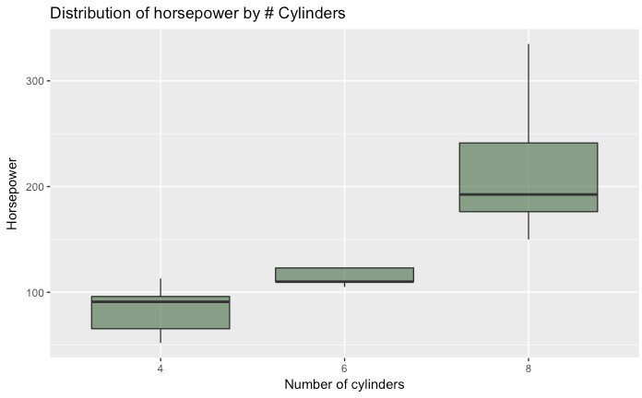
Used for one quantitative variable
Also useful for highlighting distribution
Calls out key values:
median
1st & 3rd quartiles
“fences”
outliers
Boxplot
“fence” (1.5IQR)
₃rd quartile
outlier
median
₁st quartile

Slide 6
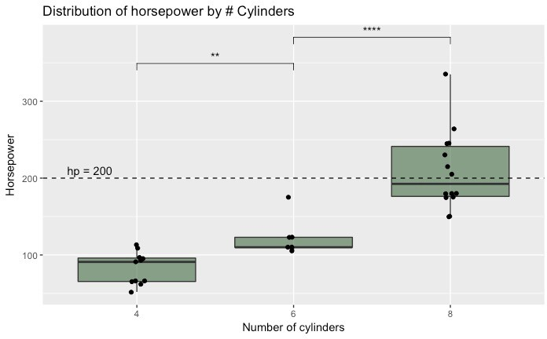
Use “jitter” to show actual values
Reference lines can help provide context
Can use annotations to show statistical significance
Boxplot

Slide 7
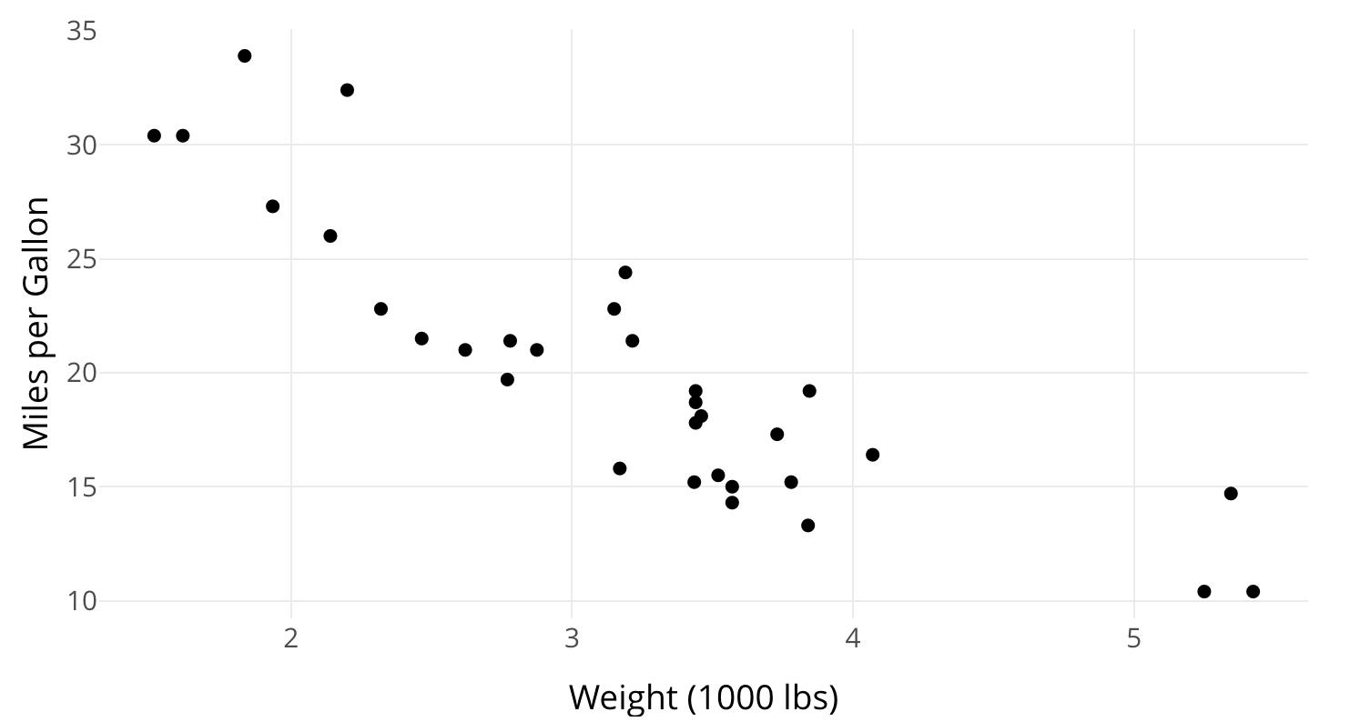
Used to show one quantitative variable X one quantitative variable
Shows the relationship between the two variables
Each point in the plot represents an observation
Scatterplot

Slide 8
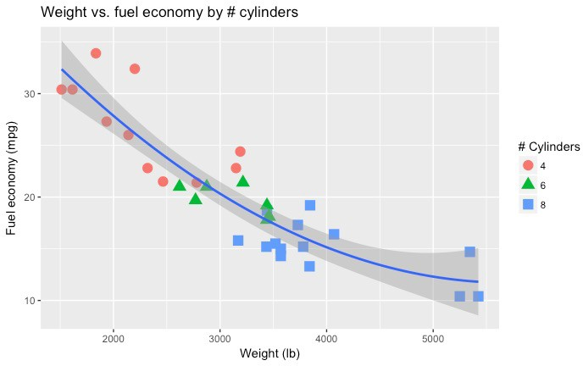
Can use color or symbol to show one quantitative variable X one quantitative variable X one categorical variable
This highlights groups
Sometimes useful to show a trend line (regression)
Scatterplot

Slide 9
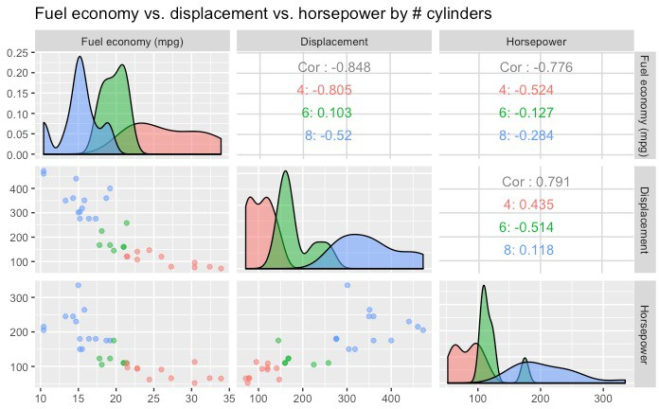
Can use to show many combinations of one quantitative variable X one quantitative variable
Combines multiple scatterplots into a matrix to show additional relationships
Scatterplot matrix (SPLOM)

Slide 10
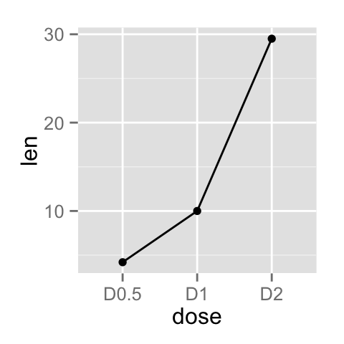
Shows the trend of one quantitative variable, often over time
Line chart

Slide 11
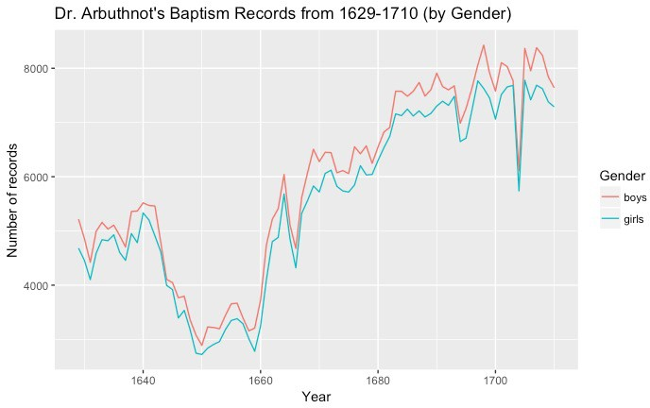
Multiple lines allow comparison of trends
Can show one quantitative variable across groups, or multiple quantitative variables (if they have the same scale)
Highlights “position switches”
Line chart

Slide 12
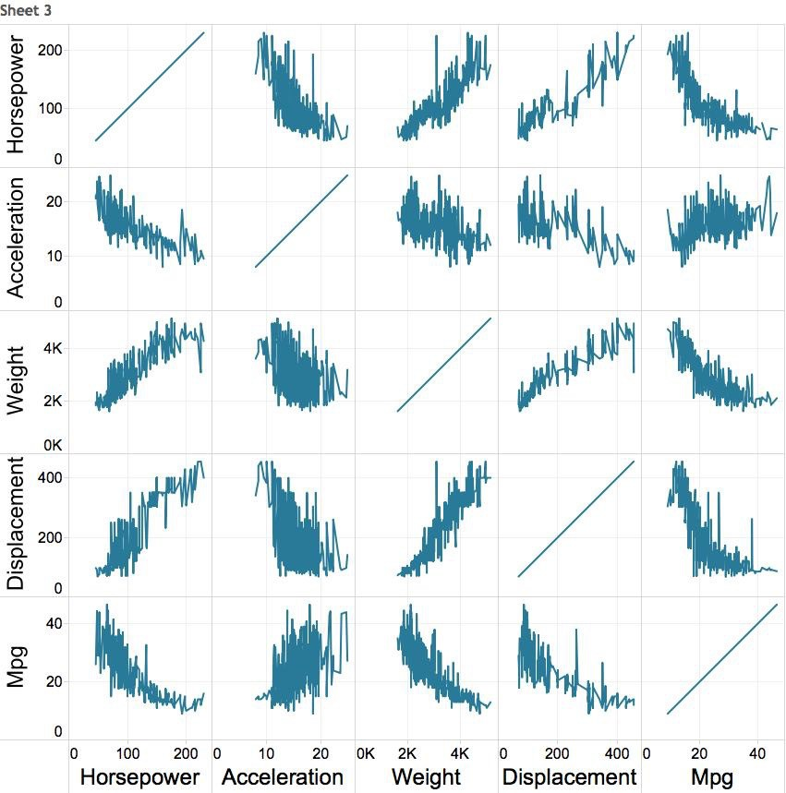

Multiple variables: line chart matrix?

Slide 13
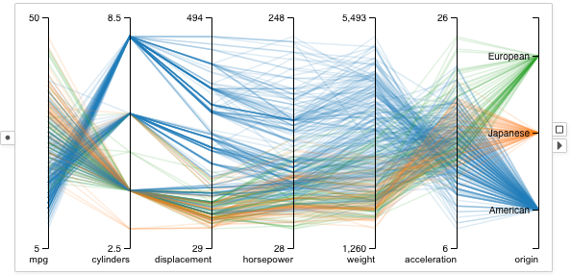
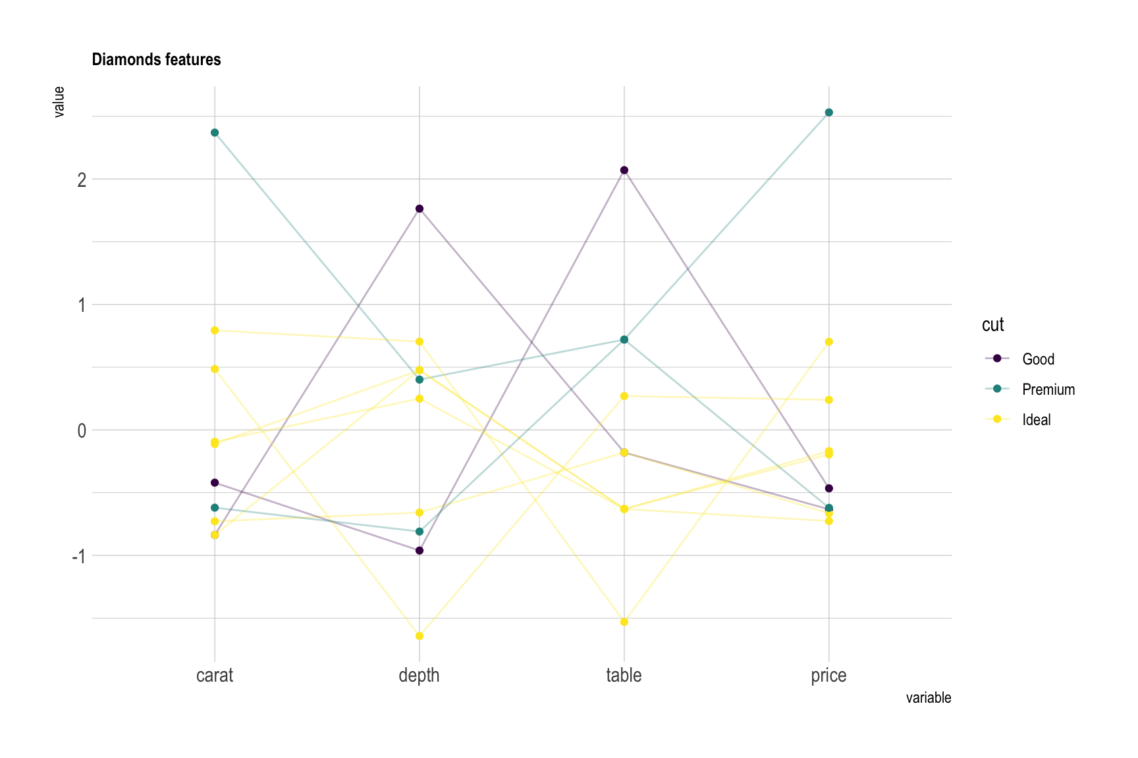
Supports (pairwise) comparison of a collection of quantitative variables
Each axis represents one variable
They may have different scales, typically you normalize them
Each line represents one observation (connecting the associated values along each axis)
Axis order matters!
Parallel Coordinates Plot
https://visflow.org/node/visualization/parallel-coordinates.html
https://www.data-to-viz.com/graph/parallel.html

Slide 14
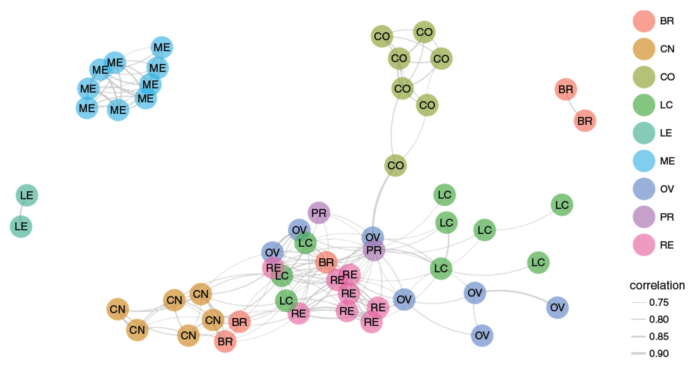
Shows graph data
Useful for showing the relationships between entities
Can use color, size, etc. to encode additional information
Caveat: network diagrams quickly become hairballs for large, dense data
Network

Slide 15
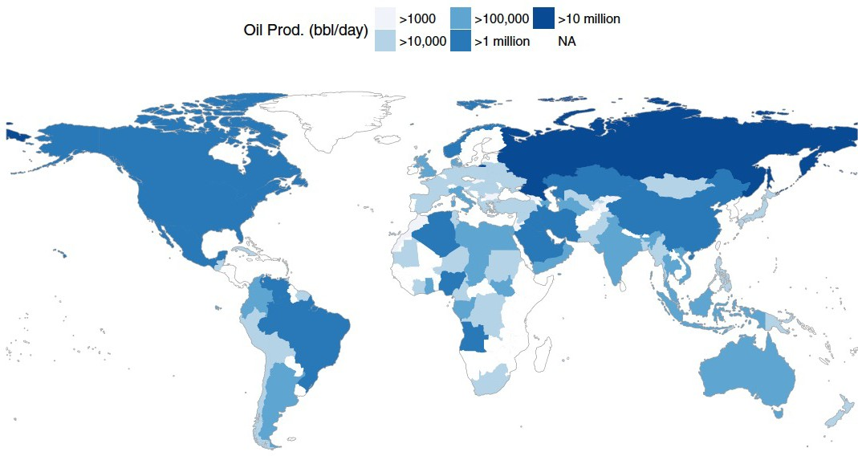
Shows geographic (spatial) data
Useful for analysis with a strong geographic component
Filled maps (choropleth) vs. points
Remember: color scale comparisons are harder for humans than size comparisons!
Map

Slide 16
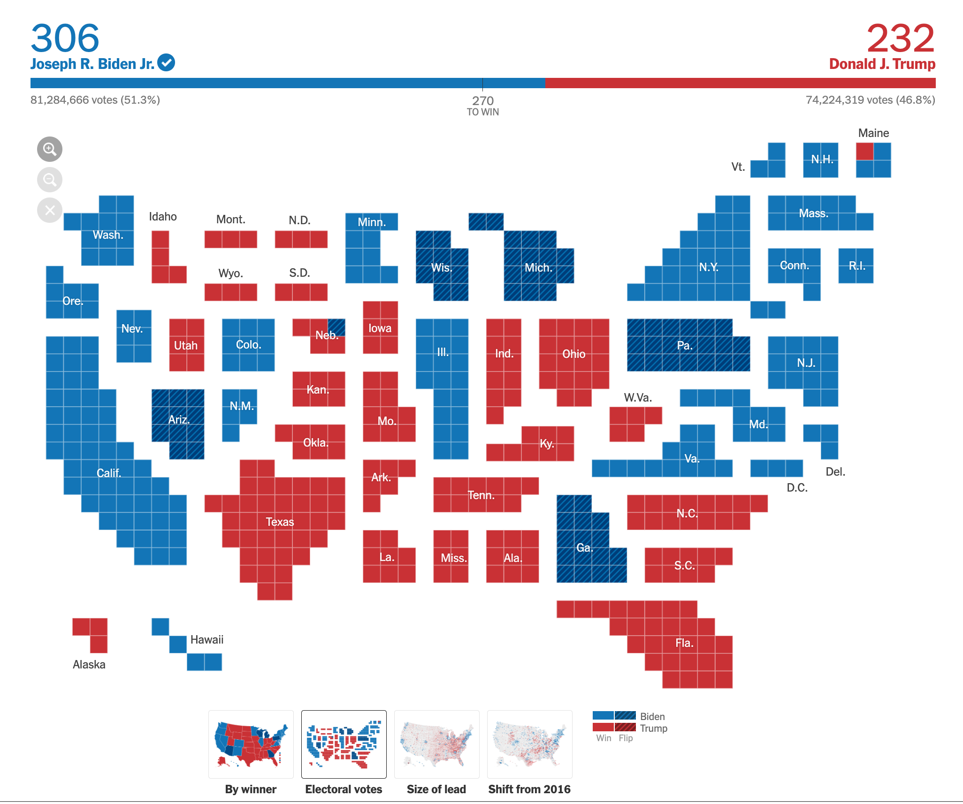
Remember to map the correct data to your visual channels
Map

Slide 17
Open the instructions for lab 2 from the course website
Find a partner and get started on it!
Submit what you have at the end of class for credit!
Lab 2

